Slide 1
Ben Salah, Maisa
Megdiche, Yecine
German Election System
1

Slide 2







ARCHITECTURE OVERVIEW
SQL
REST
2

Slide 3
DEMO
3

Slide 4
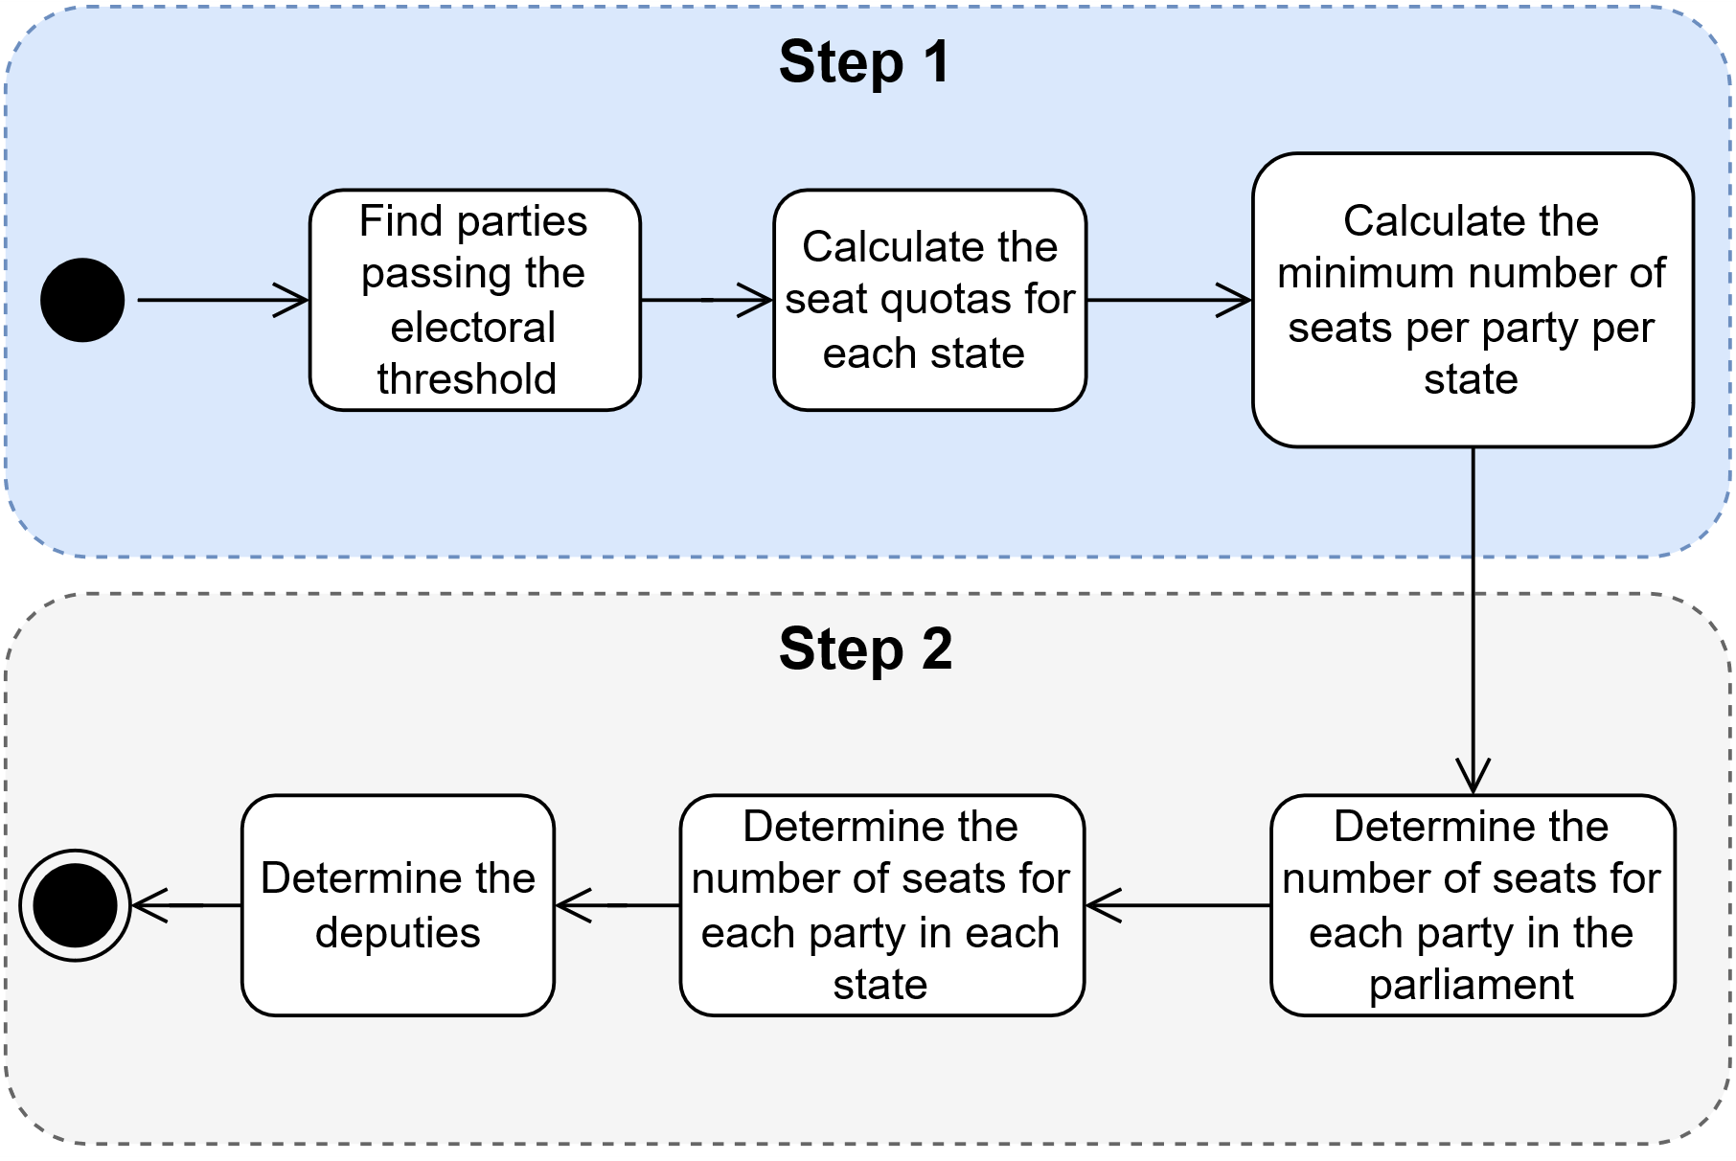
Seat Distribution
4

Slide 5
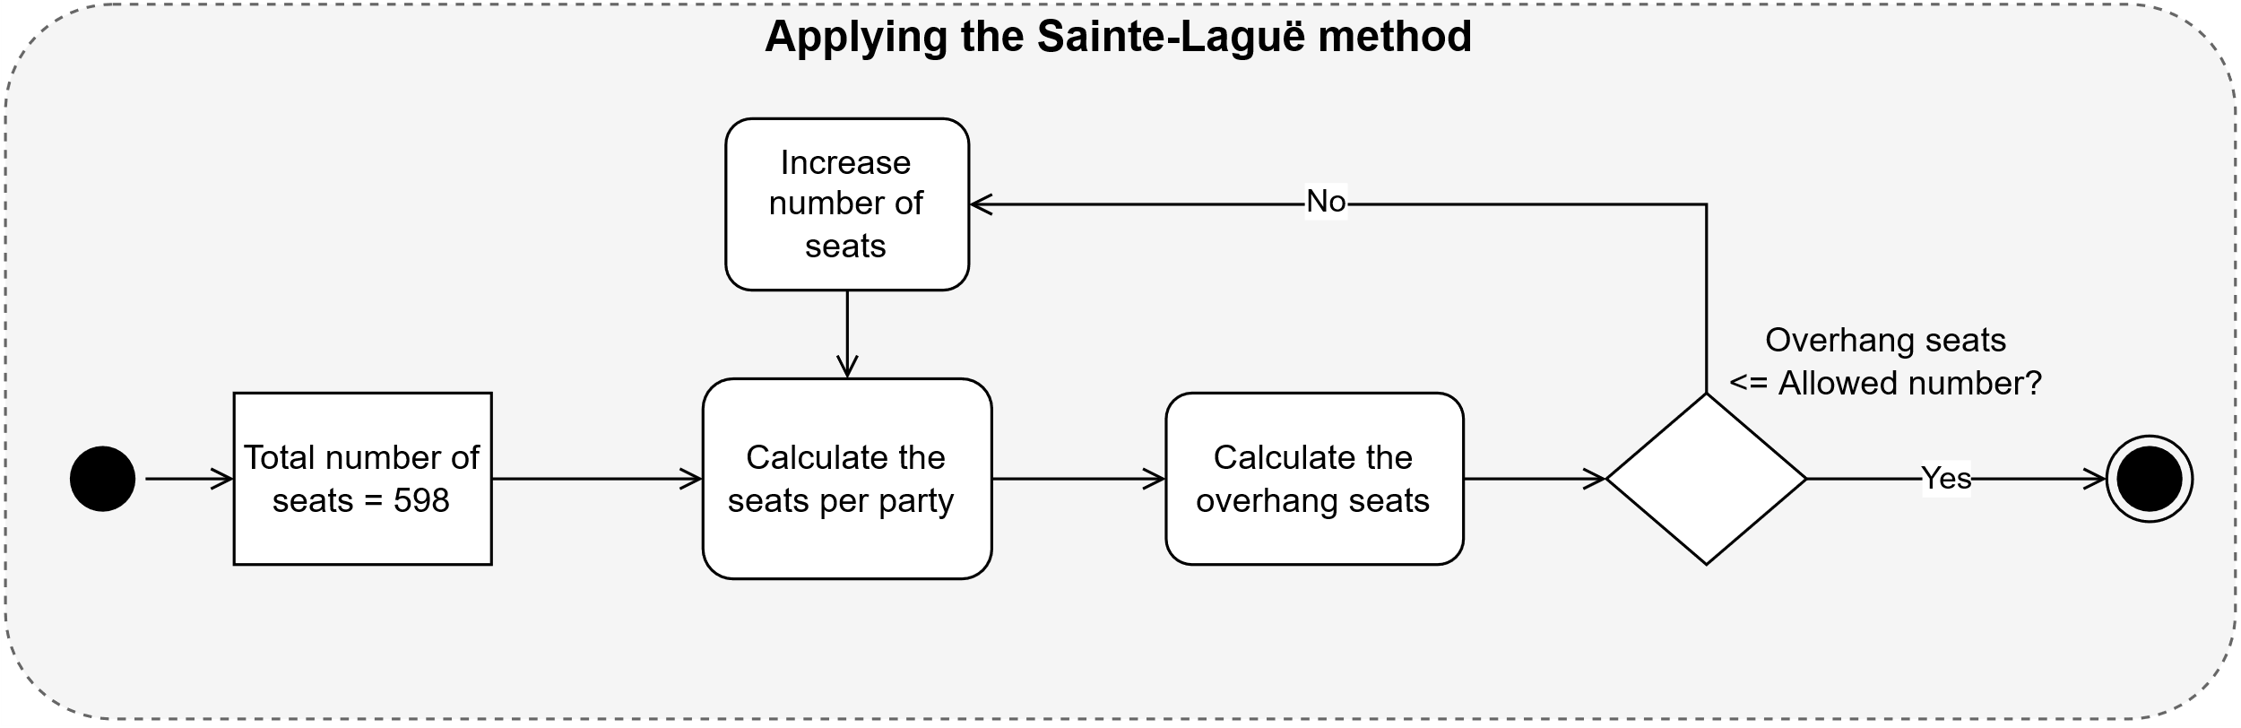
Seat Distribution
5

Slide 6
Security
Role-based access control:
Voter: Right to execute the voting function
Web anonymous : Explicit read on select views
PostgREST:
manages switching roles
provides standard secutity measures
6

Slide 7

Benchmark
Test Number | Number of users | Wait-time (seconds) | Number of Requests | Requests per second | Average response time (ms)
0 (Baseline) | 1 | 1 | 452 | 1.51 | 18
1 | 100 | 5 | 8950 | 29.86 | 27
2 | 100 | 1 | 43815 | 146.13 | 17
3 | 500 | 5 | 44619 | 148.82 | 41
4 | 500 | 1 | 51515 | 171.84 | 2221
All tests ran a total of five minutes (CPU: Intel i7-8750H (12) @ 4.100GHz, RAM: 12GB), OS: Manjaro Linux x86_64, 4.19.217-1-MANJARO).
7

Slide 8
Thank you for your attention
8

